Slide 1
Week 1(10.1-10.8) Progress Report
Siyu Zhang 10.8

Slide 2
Plan for the project
Topic: Ray Tracing
Software and Programming Languages:
Blender 2.83
Python
Build a scene which is suitable for showing ray tracing property
Different kinds of food would be a possible candidate for this
Possible areas that are need to be learned
shaders in Blender
rendering pipeline (cycles)
OSL (Open Shading Language)

Slide 3
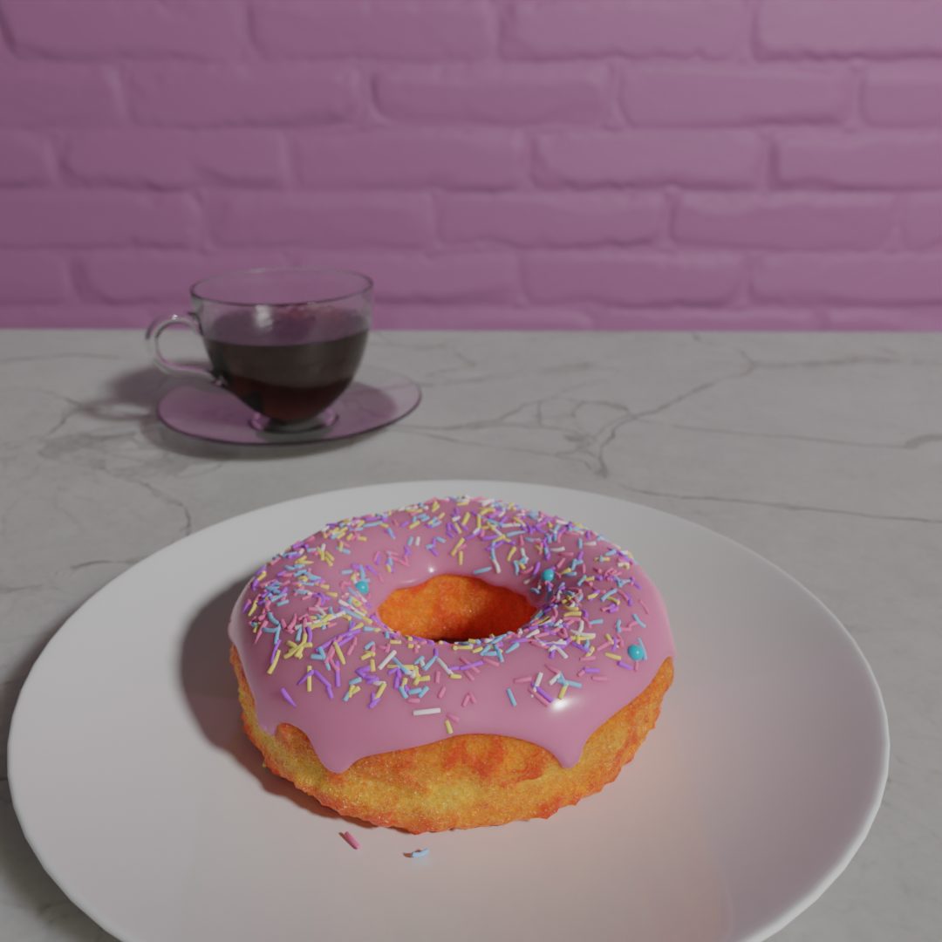
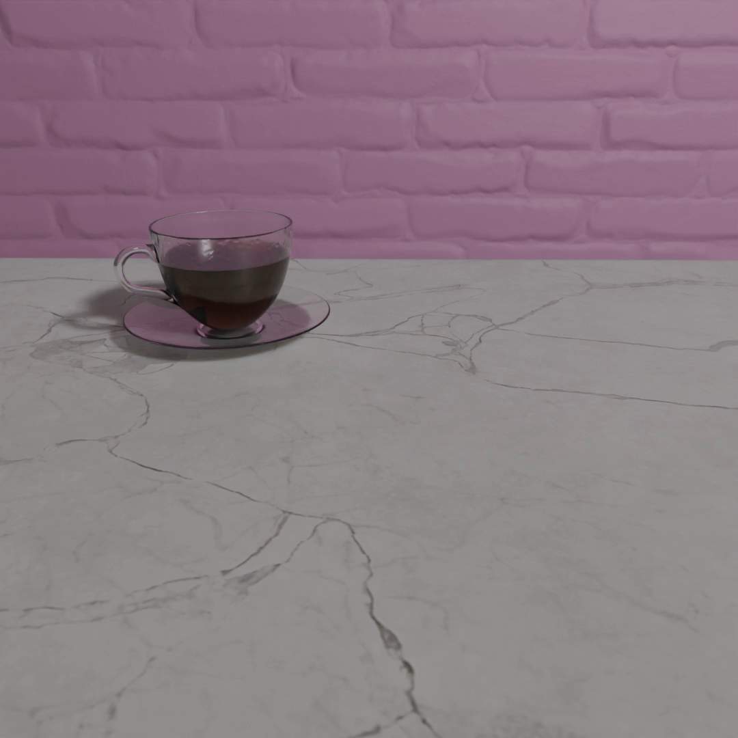
Blender learning progress
Finished Donut project by Blender Guru on YouTube
Final Animation
Final Rendered Picture

